Slide 1
E Learning Portal (Web Based Learning System)
StudyLand
Contact us: +91 705 9749 827
Email: mystudyland.edu@gmail.com

Slide 2
University of Calcutta [CC 13 Project Presentation]
A Project on E-Learning System
Submitted by:
Subhrajit Nayak
Sabyasachi Mazumder
Shybal Ghosh
Pallabi Dome
Anirban Guha
Rudra Narayan Paul
under guidance of:
Prof. Amitav Biswas
Lecturer., [Computer Science Dept.]
of Vivekananda Collge(Thakurpukur)

Slide 3

Domain Description
A learning system which is based on formalized teaching but with the help of electronic resources is known as E-Learning System.
While teaching can be based in or out of the classrooms, the use of computers and the Internet forms the major component of E-Learning.

Slide 4
Introduction

Slide 5
INTRODUCTION
In the era of internet all the essential items can be found on the internet. From groceries, electronic devices to furniture, we can buy anything on internet. Even the education system got upgraded to online. An education system which is solely based on Internet medium is called the E-Learning System.
Recently e-learning systems are experiencing rapid development. We are going through a tough time where the lives, health, economy even the education got affected. Education is the most important thing in anyone’s life. But in this time where social distancing is a must, a student can’t attend schools or colleges in regular way. So, online classes are organized by the schools and colleges which are an integrated part of E-learning System.
5

Slide 6
Abstract
E-learning uses electronic media to deliver flexible vocational education and training. It includes access to, downloading materials through the web or reading a bunch of important blogs. It also includes online access to participation in course activities (e.g. online stimulations, online group discussions). Direct use of the Internet is detectable in learning and research purposes, structured learning curriculum; constant messaging between a teacher/trainer and learner on any learning issue, or online administration of learning activities. The effectiveness of e-learning has greatly enhanced through student-centre design

Slide 7
Methodology

Slide 8

Entity Relationship Diagram

Slide 9
Entities
Admin
User
teacher
student
Schedule
Examination
Question
courses
Paper
contents
Payment Management

Slide 10
Attributes
Table | Attributes
Admin | AdminID, AdminName, AdminAdd, AdminEmail, MobileNo
teacher | id, image, name, email, password, mobnumber, status
student | id, image, name, email, password, mobnumber, status
Schedule | id, date, time, description, teacher_id
Examination | id, roll_no, date
Question | id, question_type, description
courses | id, teacherid, name, description, image, type, coursefee, status
Paper | id, exam_id, paper_marks, paper_name
contents | Id, topicid, heading, type, links, createdBy, createdAt, updatedAt
Payment Management | id, course_fee, student_id, course_id

Slide 11
Relationships
Admin manages the whole system
teacher manages contents
teacher manages Schedule
teacher manages Examination
courses has contents
courses has Payment
student enrols for courses
student browses contents
students makes Payment
Exam has Answers
Exam has Questions

Slide 12
Admin_email
id
Admin_name
Admin_phoneNo.
Admin_address
Admin
manages
Teacher_name
Course_fee
Course_number
Payment management
Student_id
Teacher_phoneNo.
Course_id
Course_fee
M
M
Course_id
Transaction_id
email
Teacher
manages
1
1
Course
Has
Makes
id
M
Examination
M
Enrol for
1
Student
id
1
Exam_time
Exam_id
manages
name
Exam_date
1
1
M
Has
browse
Student_address
Schedule
M
teacher_id
1
Content
M
Student_phoneNo
time
Has
1
date
id
1
Content_id
Ques_id
question
Content_no
Ques_type
paper
description
id
paper_name
exam_id
paper_marks

Slide 13
Data Flow Diagram

Slide 14
Data Flow Diagram
A graphic tool used to describe and analyse the moment of data through a system – manual or automated – including the processes, stores of data, and delays in the system. Data flow diagrams are the central tools and the basis from which other components are developed. The transformation of data from input to output, through processes, may be described logically and independently of the physical components associated with the system.

Slide 15
Context Level Diagram
Response
Teacher
Overview
E-Learning System
Request login/upload contents/take exams
Admin
Request login/manages teachers and courses
Request login/view courses/give exams
Response
Student

Slide 16
Level 0 Data Flow Diagram
Teacher
Student
Admin
Login/Upload contents
Response
Login/Visits Courses
Response
Request Data
Response
Teacher Process
0.3
Student Process
0.2
Admin Process
0.1
Store Teacher’s Data
Fetch Records
Store Student’s Data
Store Admin’s Data
Fetch Records
Fetch Data
Data Storage

Slide 17
Level 1 DFD of Admin
Username/Password
Login 0.1.1
admin
Request Login
View profile
View profile
Updates teacher’s profile
teacher
Manages teacher’s records
Teacher Management 0.1.2
Show data
View profiles
Updates student’s profile
student
Manages student’s records
Student Management 0.1.2
Show data
Response
course
Store courses data
Manages courses
Course Management 0.1.2
Show data
Admin
Store courses related questions
View courses
question
Show those questions
Manages payment
Payment Management 0.1.4
Store payments data
payment
View stored payments data
Show data
Store answer
answer
Manages examination
Examination management 0.1.5
Show data
Store questions
response
Show data
question
Replies to the feedback
Feedback Response 0.1.6
Give feedback
View the feedbacks
feedback
Check feedbacks

Slide 18
Level 1 DFD of Student
student
courses
student
Show data
Username/Password
Show data
question
Store data
Show data
Search for courses
Login 0.2.2
Store data
Registration 0.2.1
Show data
Courses 0.2.3
Response
View profile
View Courses
Enroll for exam on a specific course
Username/Password
Store data
answer
Enter data
Give exams
Exam 0.2.4
Show data
Student
Get results
Show data
Give feedback
Make payment for courses and exams
Store data
Get reply of the feedback
question
Gets Invoice
Pay for exams
Feedback Response 0.2.6
Payment 0.2.5
Invoice
Store feedback
Fetch the data
Show data
Store payment details
feedback
payment

Slide 19
Level 1 DFD of Teacher
teacher
courses
teacher
Username/Password
Show data
question
Show data
Show data
Search for courses
Store required data
Login 0.3.2
Store questions related to courses
Registration 0.3.1
Show data
Courses 0.3.3
answer
Response
View profile
Upload Courses
Store answers
Username/Password
View Courses
Show data
Enter data
Publish results
Exam 0.3.4
Teacher
Take exams
Give feedback
Get reply of the feedback
View schedule
Show data
upload schedule
Store questions
Feedback 0.3.6
Schedule
0.3.6
question
Store feedback
Fetch feedback
Store schedule data
feedback
schedule

Slide 20
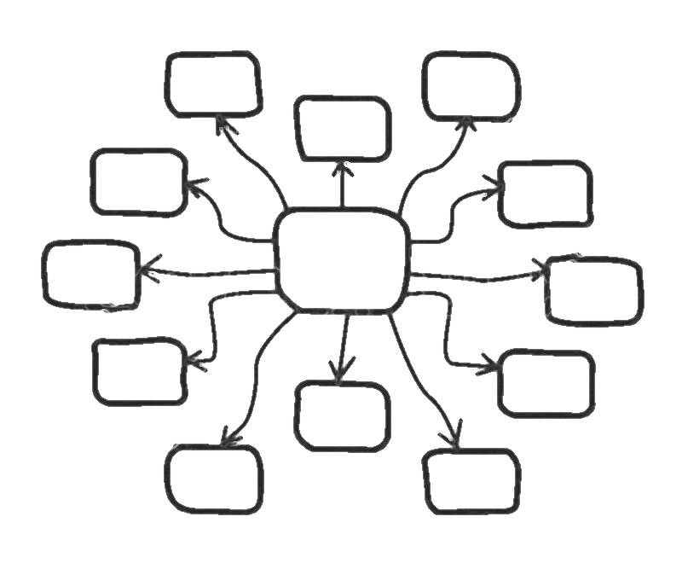
Use-Case Model

Slide 21
Use-case diagram
Teacher
Register
Student
include
extend
Display Error
Verify Id
Login
Teacher
Student
Popular courses
include
User
extend
Display Error
Manages
Verify Id
Get started
View courses and details
Contact us
Update + manages
Call us
Email us
Our address
Assist + manages
Admin

Slide 22
Use-case diagram of Student
View available courses
Manage and update
Choose courses
View course details
Choose course duration
Given Exam
Course enrollment
Student
Upload Answer paper
Start Course
Payment
include
Verify Payment
Log out
View Contents
extend
View performance and Marks
Download contents
Show error message
Edit profile
Edit DOB
Manage
Edit Profile photo
Edit phone number
Change password
Admin
Update

Slide 23
Use-case diagram of Teacher
View available courses
Edit
View course
My courses
Delete
Create courses
Add content
Delete Content
Edit content
Teacher
Exam
Manage and update
Edit Exam Date/Time
Log out
Create Question Paper
View Answer Paper
Upload Marks and Remarks
Edit profile
Edit Profile photo
Edit phone number
Change password
Edit DOB
Admin
Update

Slide 24
Screen-Shots

Slide 25
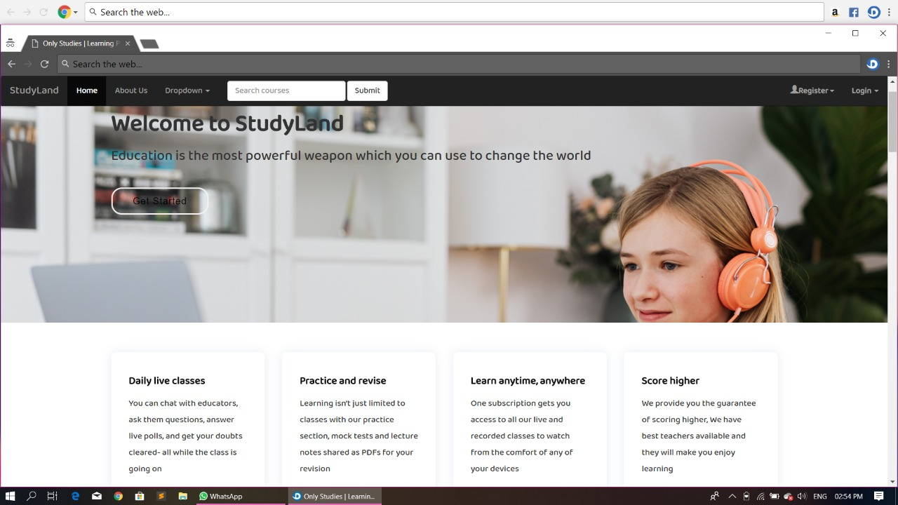
Home Page

Slide 26
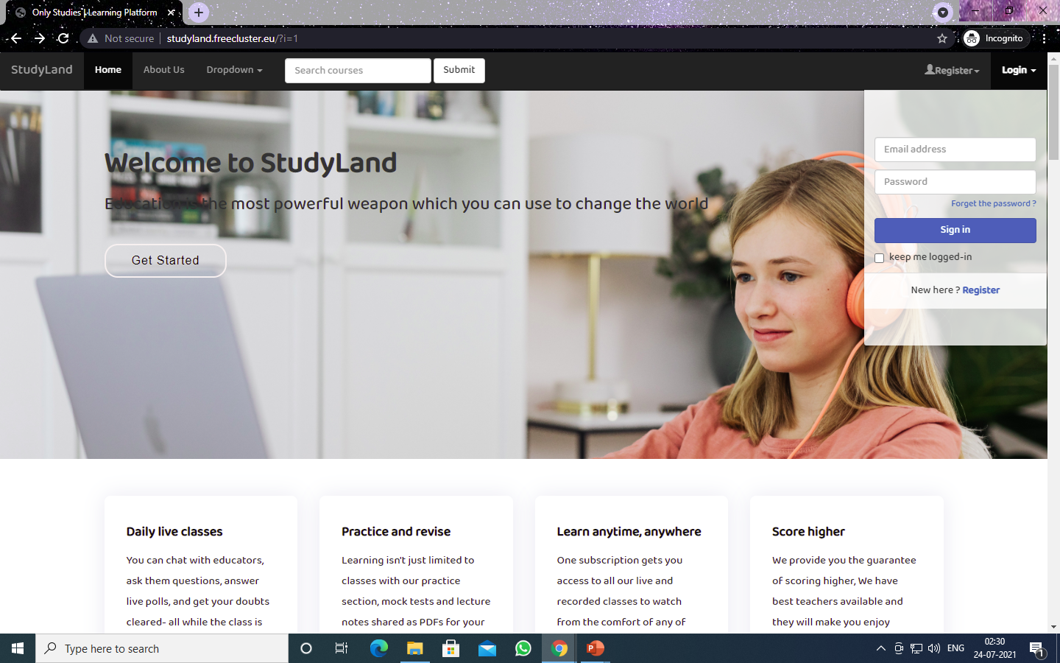
Login for Teacher/Students

Slide 27

Registration Page of a Student

Slide 28

Registration Page of a Teacher

Slide 29
Class Diagram

Slide 30
Admin
0..1
Teacher
Manage
1..*
1..*
Courses
-Id: string
-Name: string
-Email: string
-Address: string
-Phone No: int
+Id: string
-Name: string
-Email: string
-Phone No: int
+Id: string
+Fee: int
+Numbers: int
1..1
0..1
0..*
-AddLectures()
-ManageCourses()
-ManagesSchedules()
-ManagesExam()
+GetEnrolledStudents()
-ManagesByTeacher()
-ManagesByAdmin()
+AddCourses()
+EditCourses()
+DeleteCourses()
-AddNewTeacher()
-ModifyTeachers()
-RemoveTeachers()
-ModifyStudents()
-AddNewAdmin()
-ModifyAdmin()
-AddNewCourses()
-ModifyCourses()
-ManagePayments()
0..1
Schedule
+Id: string
+Date: int
+Time: int
+TeacherId: string
0..*
Manages Payment
+AddSchedules()
+DeleteSchedules()
+EditSchedules()
Create/Remove Student
Contents
Student
+Id: string
+Number: int
0..*
Payment Management
+Id: string
-Name: string
-Address: string
-Phone No: int
+Id: string
-StudentId: string
-CourseId: string
-CourseFee: string
+CreateContent()
+EditContent()
+DeleteContent()
Enrol for Courses
-EnrolForCourses()
-BrowseContent()
-MakesPayments()
0..1
-AddPayment()
-EditPayment()
0..*
1..*
Browse
Questions
Examination
Answer
+Id: string
+Type: string
+CourseId: string
+Id: string
+Date: int
+Time: int
+Id: string
+Type: string
+QuestionId: string
+GetQuestion()
+AddQuestion()
+EditQuestion()
+DeleteQuestion()
+GetExamination()
+AddExamination()
+EditExamination()
+DeleteExamination()
+GetAnswer ()
+AddAnswer ()
+EditAnswer ()
+DeleteAnswer()

Slide 31
Functional Flowchart

Slide 32
E-Learning portal
Admin
Teacher
Student
Login to system
Check Credentials
Check Roles of access

Slide 33
Admin
Teacher Management
Student Management
Payment Management

Slide 34
Teacher
Subject
Course Details
Teacher Profile
Student
Course
Student Profile

Slide 35
Subject
Online Classes
Assignments
Study Materials
Course
Course Name
Course Duration
Course Fess

Slide 36
Future Scope

Slide 37
There are still some place to upgrade this software in a broad level. Some of the aspects are-
Live Classroom: A confine space where a student will experience like a classroom but virtually.
Video Content: Pre-recorded content such as lectures, documentaries, and other video content may be delivered in future.
Internal Communication: An internal messaging system to discuss about certain topics.
Online Examination: Online Examination system for the students to check their merits.
Extra-Curricular Activities: The value of extra curricular activity is irreplaceable in today’s world.

Slide 38
Conclusion

Slide 39
We have a few plans for this project which is mentioned in the future scope portion, but we are unable to implement those things due to lack of time. The frontend of this project has been developed using HTML, JavaScript, CSS and Bootstrap. The backend of this project has been developed by PHP and MySQL.
This technologies are evolving at a rapid speed in today’s world. So, there will always be a scope to upgrade this software.

Slide 40
Thank You!!

